Slide 1
Penetration testing report
Anonymous team

Slide 2
Contents
1. Executive Summary
2. Methodology: Phase 1
3. Methodology: Phase 2
4. Methodology: Phase 3
5. Methodology: Phase 4
6. Methodology: Phase 5
7. Findings
8. Recommendations

Slide 3
What is a Metasploitable2 ?
The Metasploitable virtual machine is a purposefully vulnerable version of Ubuntu Linux that may be used to test security tools and demonstrate common flaws. This virtual machine’s version 2 is now available for download, and it contains even more vulnerabilities than the initial image. VMware, VirtualBox, and other popular virtualization platforms are all compatible with this virtual machine. The network interfaces of Metasploitable are bound to the NAT and Host-only network adapters by default, and the image should never be exposed to a hostile network. This Virtual Machine (metasploitable2) can be used to conduct security training, test security tools, and practice common penetration testing techniques.

Slide 4

Methodology: Phase 1 Reconnaissance
Objectives:
Gather information about the target system, including domain names, subdomains, network infrastructure, and associated services.
Techniques Used:
Open-Source Intelligence (OSINT), DNS Enumeration using tools like Nmap and Dig.
Tools Utilized:
Nmap, derbuster.
Results:
Key data included, server names, and associated subdomains.

Slide 5
Methodology: Phase 2 Scanning & Vulnerability Assessment
Objectives:
Discover open ports, services, and associated vulnerabilities through scanning and vulnerability assessment.
Network Scanning:
Identified IP range and conducted extensive Nmap scan to identify open ports and services.
Vulnerability Assessment:
Used OpenVAS to detect misconfigurations and potential security issues, provided detailed report with CVSS scores.
Critical Ports Identified:
Ports 1524 (BIND Shell), 8180 (Apache Tomcat), 5900 (VNC), 21 (FTP, vsFTPd 2.3.4), 22 (SSH, OpenSSH 4.7p1), 80 (HTTP, Apache 2.2.8), 139/445 (Samba, smbd 3.0.20).

Slide 6
Methodology: Phase 3 Exploitation & Gaining Access
Objectives:
Exploit identified vulnerabilities to gain unauthorized access to the target system.

Slide 7
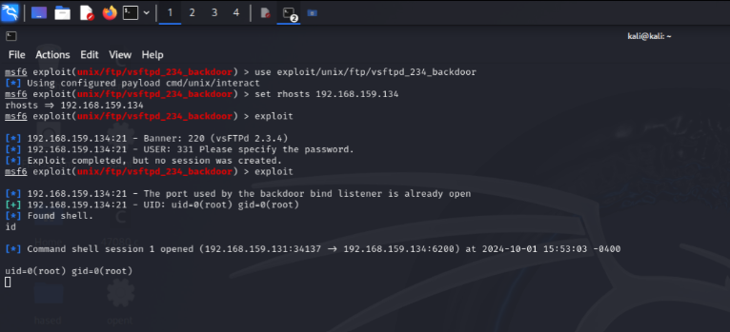
Exploitation Techniques:
Port 21 (FTP) - Anonymous Login and Metasploit.

Slide 8
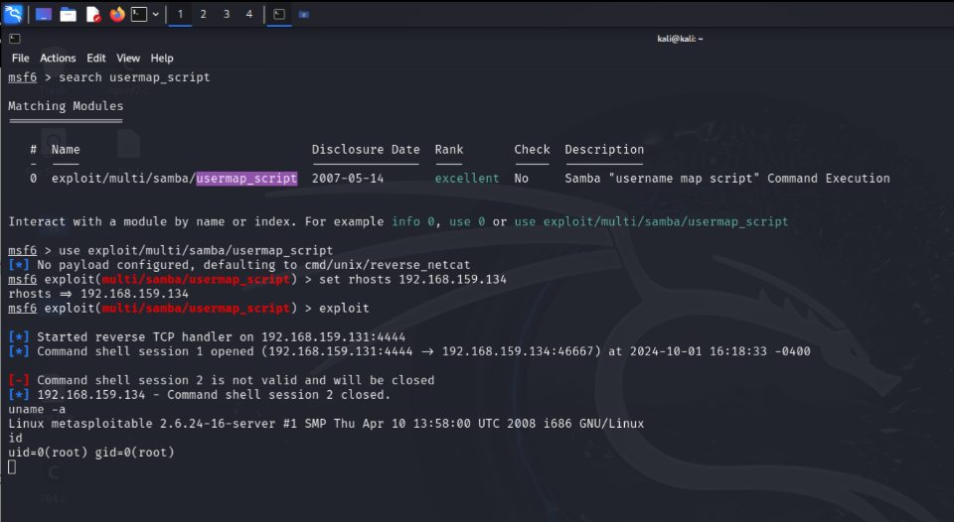
Exploitation Techniques:
Port 139 & 443 (Samba) - Metasploit usermap_script exploit.

Slide 9
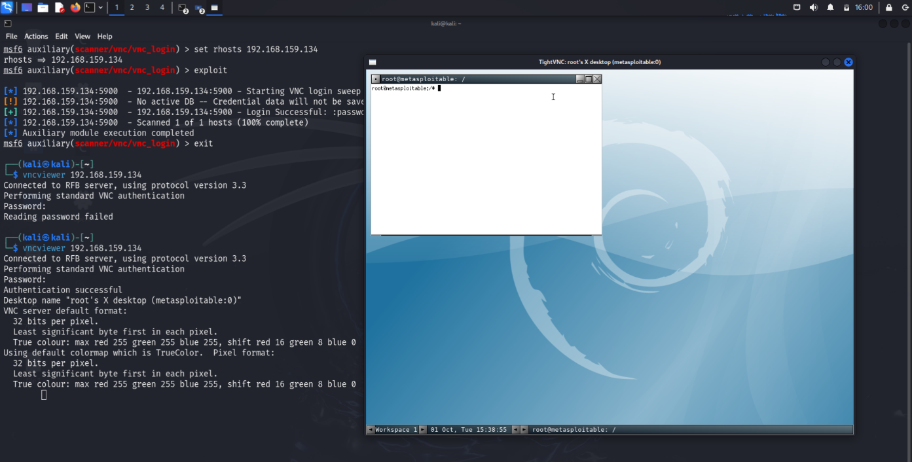
Exploitation Techniques:
Port 5900 (VNC).

Slide 10
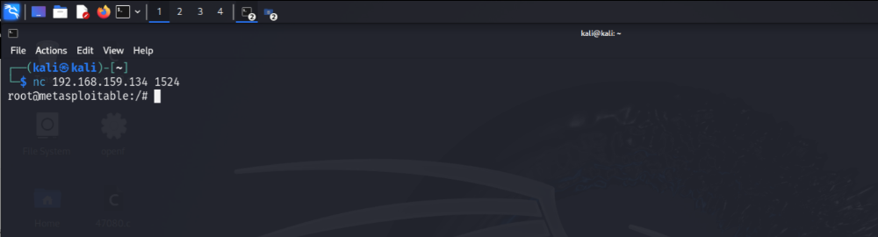
Exploitation Techniques:
Port 1524 (BIND Shell).

Slide 11
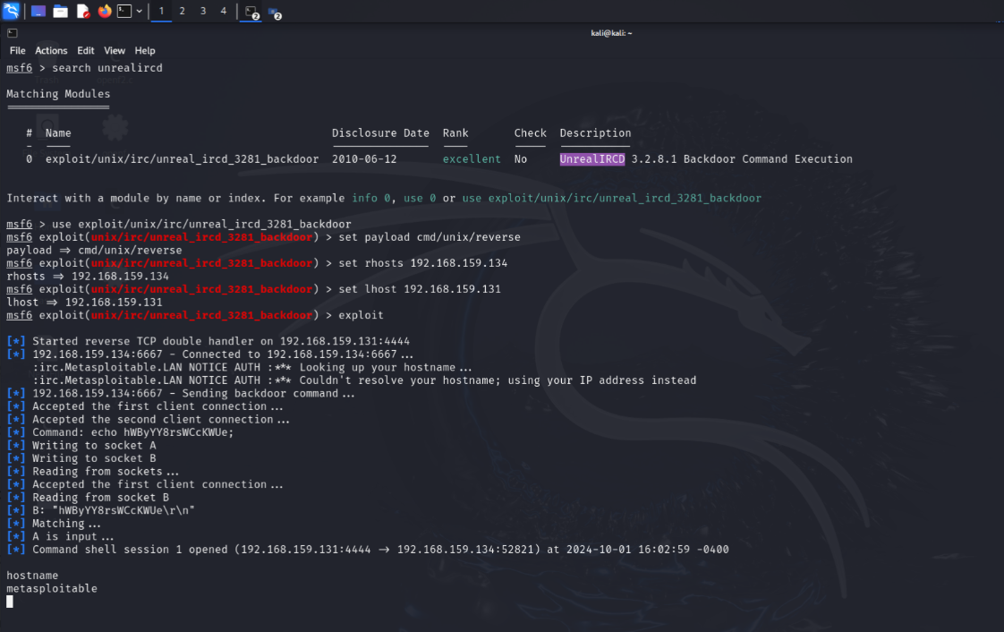
Exploitation Techniques:
Ports 6667 (UnrealIRCD).

Slide 12
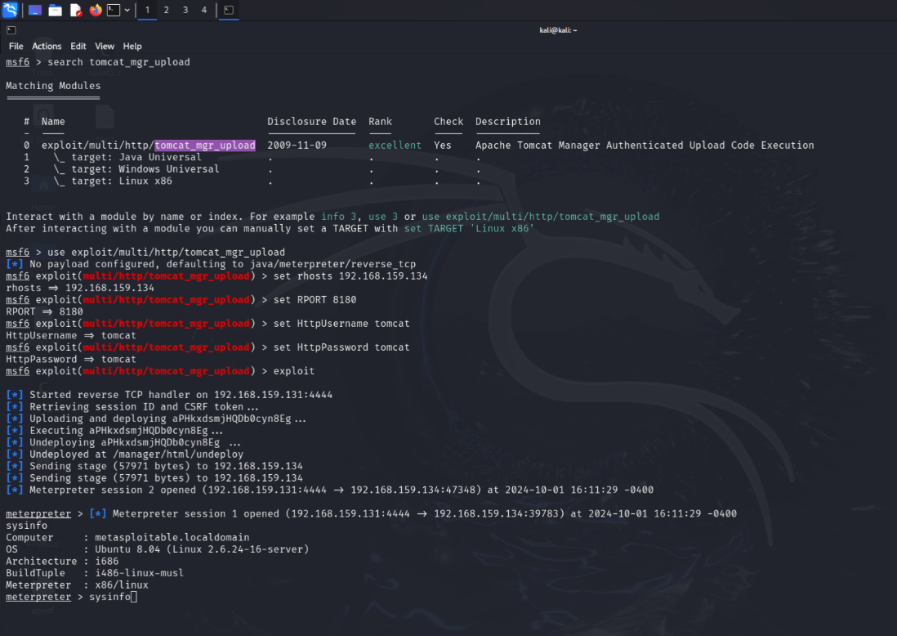
Exploitation Techniques:
Port 8180 (Apache Tomcat).

Slide 13
Methodology: Phase 4 Maintaining Access & Privilege Escalation
Objectives:
Establish persistent access and escalate privileges within the compromised environment.
Methods for Maintaining Access:
Backdoor Installation, Keylogger Deployment, Samba Exploit, IRC Bot Installation, Tomcat Exploit.
Escalation Techniques:
Sudoers Misconfiguration, Kernel Exploits.
Results:
Maintained access and escalated privileges across multiple services, providing full control over the target system.

Slide 14
Methodology: Phase 5 Post-Exploitation & Lateral Movement
Objectives:
After successfully gaining initial access and establishing persistence, the next focus was on lateral movement within the target network. This phase aimed to identify and exploit additional vulnerable systems, expanding the attacker's footprint within the environment.
Techniques for Lateral Movement:
Port 5900 (VNC) - Credential Dumping.
Ports 139 & 443 (Samba) - Exploit Network Shares.
Port 8180 (Apache Tomcat) - Active Directory Attacks.
Port 1524 (BIND Shell) - Reverse Shell and Command Execution.
Ports 6667 (UnrealIRCD) - IRC Bot Installation.

Slide 15

Findings
The penetration test uncovered critical vulnerabilities across various services, including anonymous FTP access, misconfigured Samba permissions, remote command execution vulnerabilities, weak authentication mechanisms in VNC, known backdoor vulnerabilities in UnrealIRCD, and default credentials in Apache Tomcat.

Slide 16
Recommendations
To address the identified vulnerabilities and enhance the overall security posture:
Disable anonymous FTP access.
Review and harden Samba configuration settings.
Patch the vulnerable software to eliminate the bind shell vulnerability.
Implement strong authentication mechanisms for VNC.
Update UnrealIRCd to the latest version.
Change default credentials and enforce strong password policies in Apache Tomcat.

